Slide 1
Antimicrobial Advancements Using Nanocomposite for Enhanced Hygiene and Comfort
Dr. Suneeta Panicker
Department of Microbiology
Dr. D. Y. Patil UniTech Society’s
Dr. D. Y. Patil Arts, Commerce and Science College, Pimpri, Pune, India

Slide 2
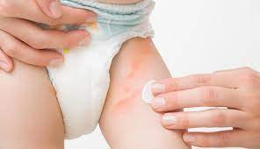
Introduction
Increased use of Sanitary napkins and diapers
Known to cause urinary tract infection, rashes, vaginal infections and sometime toxic shock syndrome, making the user uncomfortable (Tanasa et al., 2023; Guilherme et al., 2021).
Due to warmth, moisture and accumulation of blood or excreta around the intimate area.
Commercially available sanitary napkins and diapers lacks antimicrobial properties.
Thus, to inhibit such microbial growth we aimed to make a metal based nanocomposite that can be incorporated into sanitary napkins and diapers for its antimicrobial activity ensuring enhanced hygiene and comfort along with environment sustainability by opting green synthesis method.

Slide 3
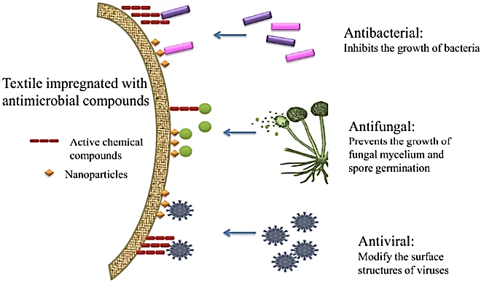
Introduction
Continued
The project revolves around utilizing Cassia fistula [Golden shower tree] leaf extract for green-synthesis of Selenium, Silver and Copper nanoparticles (Remya et al., 2015) and a composite of them.
The innovative aspect approach lies in the use of Se-Ag-Cu nanocomposite for benefits of synergistic antimicrobial

Slide 4
Objectives
Cassia fistula leaf extract preparation
Synthesis of selenium, silver and copper nanoparticles using leaf extract
Characterization of nanoparticles
Antimicrobial assay of nanoparticles
Synthesis of nanocomposite and its antimicrobial assay
Incorporation of nanocomposite on cellulose matrix used in sanitary napkins and diapers and its antimicrobial assay

Slide 5
Methodology
Cassia fistula Leaf extract preparation by decoction method and Soxhlet extraction method (Alagesan & Venugopal, 2018)
Green synthesis of selenium nanoparticles using leaf extract of Cassia fistula (Gunti et al., 2019)
Green synthesis of silver nanoparticles using leaf extract of Cassia fistula (Masum et al., 2019)
Green synthesis of copper nanoparticles using leaf extract of Cassia fistula (Perez et al., 2023)
Preparation of selenium –silver – copper nanocomposite (Eslami et al., 2019)
Incorporation of nanocomposite into cellulose matrix used in sanitary napkins and diapers (Pasha et al., 2023)
Antimicrobial assay of NPs and NC (Urnukhsaikhan et al., 2021)

Slide 6
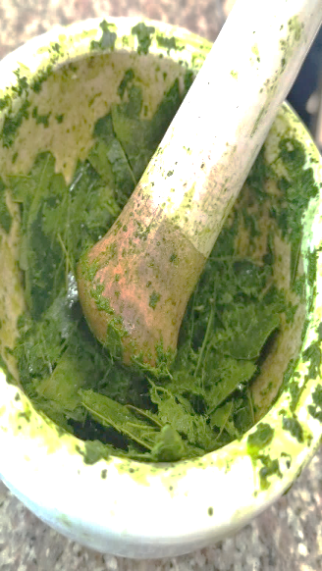
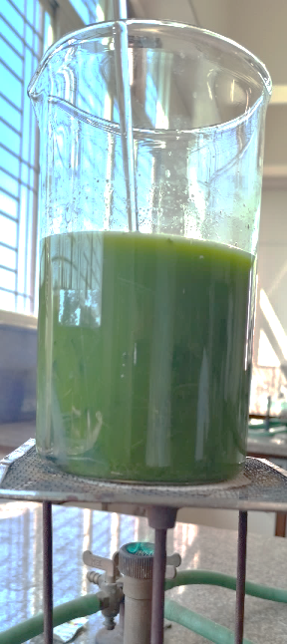
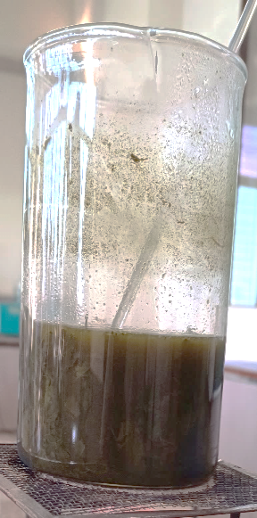
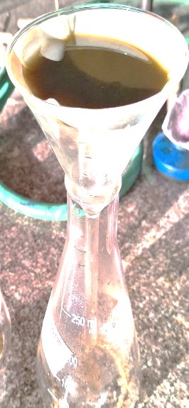
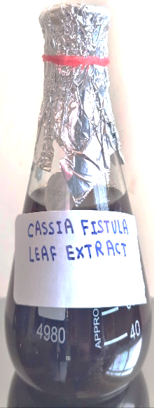
Results
Cassia fistula Leaf extract preparation by decoction method:
Fresh leaves of Cassia fistula cleaned using distilled water,
Crushed using mortar and pestle.
6o grams of crushed leaves added in 600 ml of distilled water, boiled until 200ml left out.
Filtered using Whatman filter paper.
Cleaned fresh leaves of cassia fistula
Leaves were crushed using mortar and pastle
60gms of crushed leaves in 600ml of distilled water
Boiled till it becomes 200ml
Extract filtered using whatmann filter paper
Aqueous extract of cassia fistula leaves

Slide 7
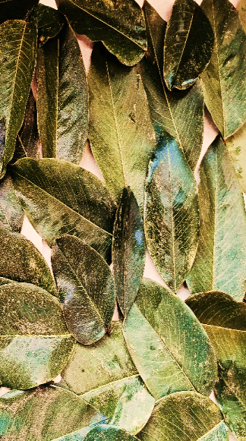
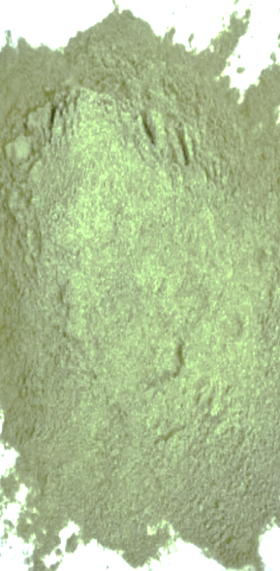
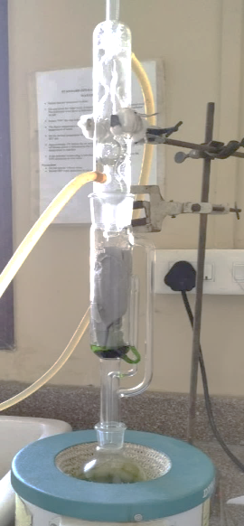
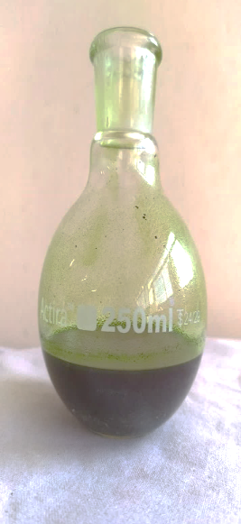
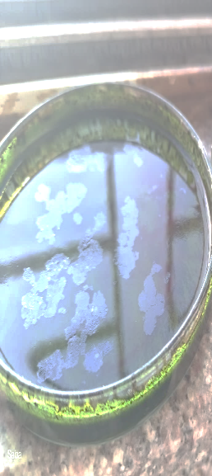
Results
Cassia fistula leaf extract preparation by organic extraction method- cleaned leaves were kept for dying under shade for 10 days, the leaves were grind to make a fine powder. 20 gms of powdered leaves were extracted using 175ml of solvent methanol in the Soxhlet chamber. Extract along with solvent was air dried and paste was stored at 4C.
Cleaned fresh leaves of cassia fistula
Leaves dried in shade for 10 days
Dried leaves grind into fine powder
Organic extraction of leaf powder using Soxhlet chamber
Leaf extract with methanol solvent
Solvent extract air dried and kept at 4C

Slide 8
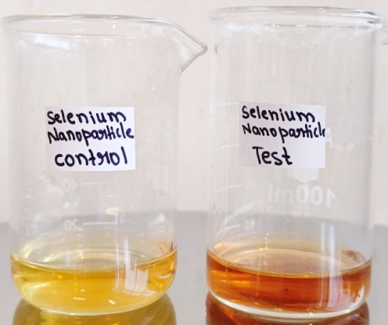
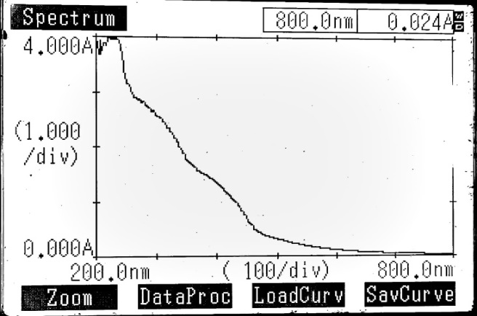
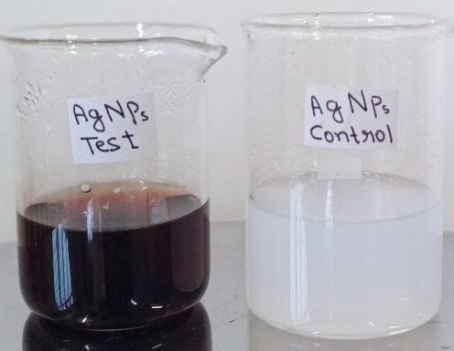
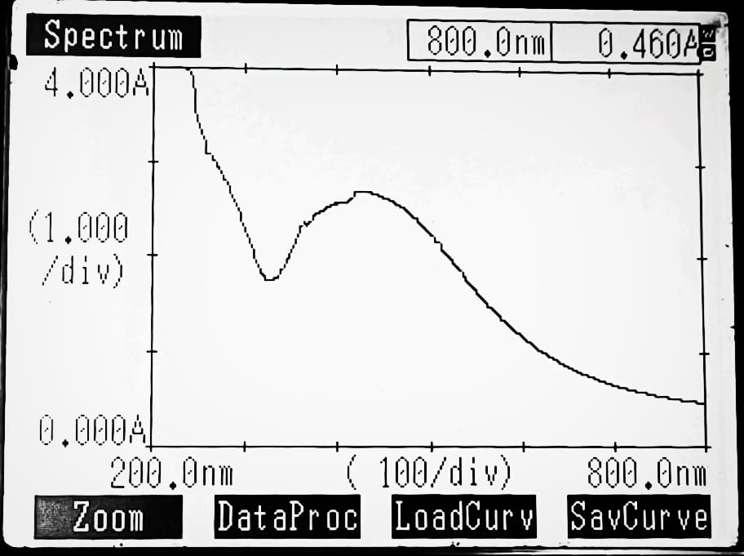
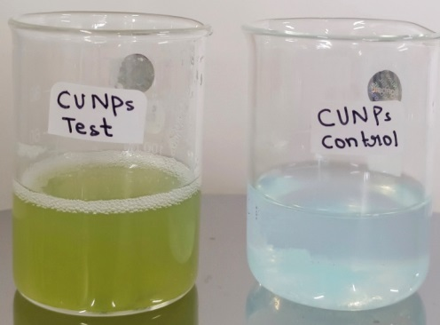
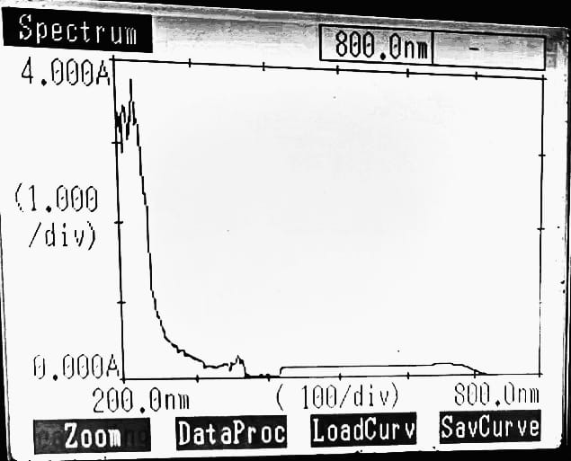
NP Characterization
(DECOCTION)
(232nm)
SELENIUM NANOPARTICLES
UV-VIS spectrophotometry
(DECOCTION)
(424nm)
SILVER NANOPARTICLES
UV-VIS spectrophotometry
(DECOCTION)
(210nm)
COPPER NANOPARTICLES
UV-VIS spectrophotometry

Slide 9
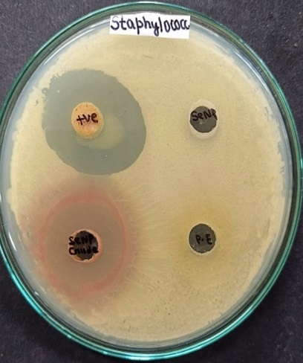
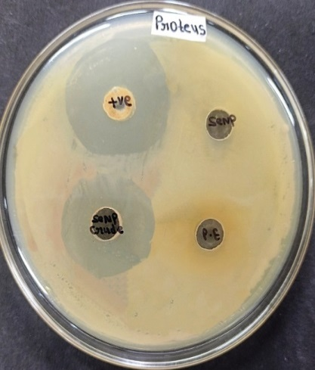
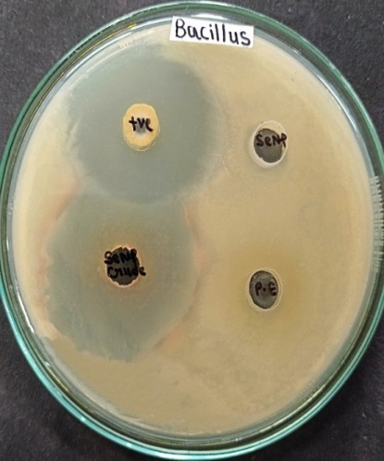
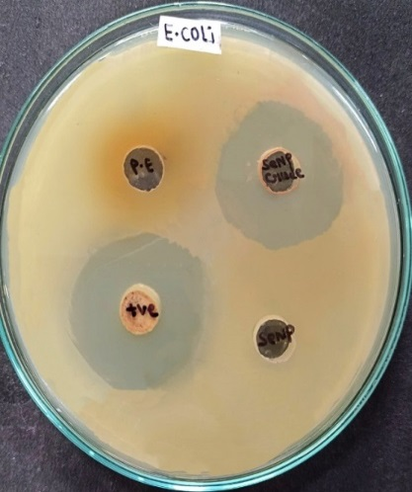
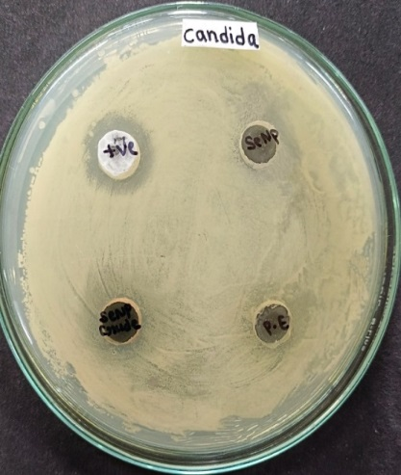
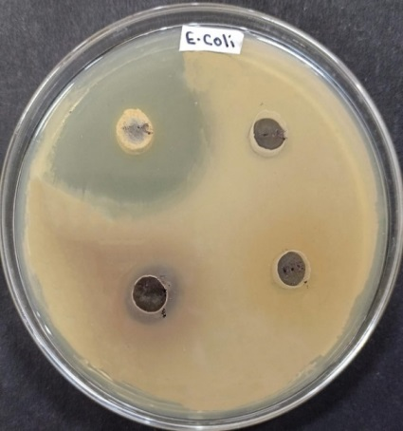
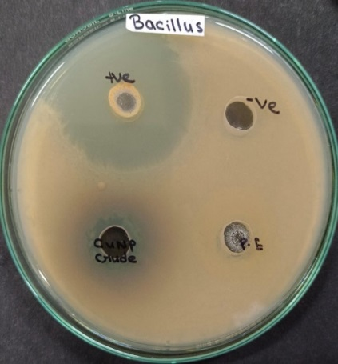
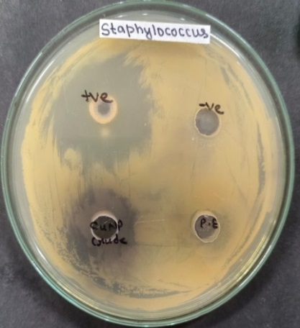
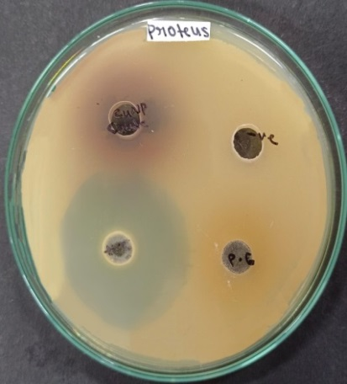
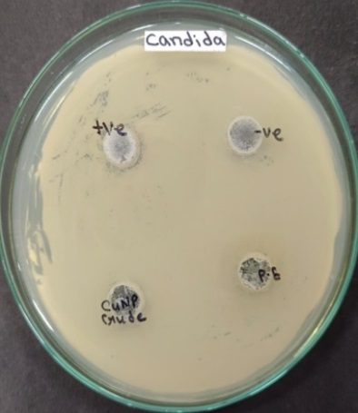
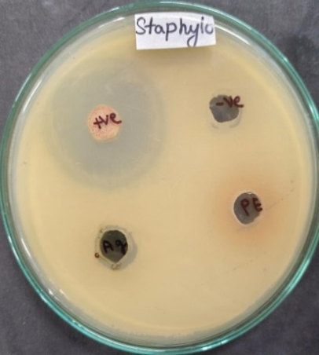
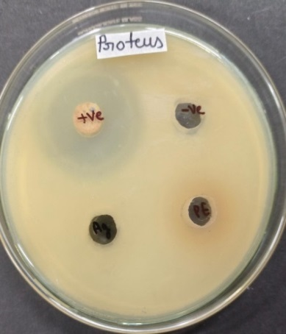
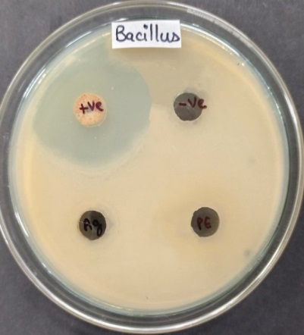
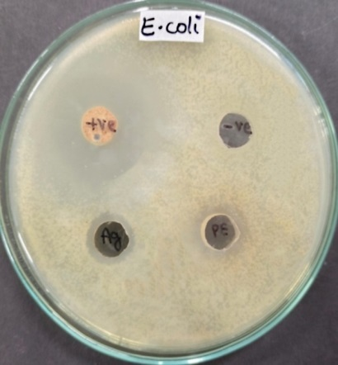
ANTIMICROBIAL ASSAY OF NANOPARTICLES
Staph
Proteus
Bacillus
E.coli
Candida
SELENIUM NANOPARTICLE
E.coli
Bacillus
Staph
Proteus
Candida
COPPER NANOPARTICLE
Staph
Proteus
Bacillus
E.coli
SILVER NANOPARTICLE

Slide 10
Antimicrobial activity of NPs
Test organism | Zone of inhibition (mm)
 | SeNp crude | AgNp crude | CuNp crude
Proteus | 25 | - | -
Staph | 30 | 10 | 17
Bacillus | 35 | - | 16
E. coli | 30 | 10 | 14
Candida | 15 | - | -
D/W
DMSO
Test organism | Zone of inhibition (mm)
 | SeNPs | AgNPs | CuNPs
E. coli | 9 | - | 20
Bacillus | - | - | 14
Staph | - | - | 14
Proteus | - | - | 20
Candida | - | - | -
Test organism | Zone of inhibition (mm)
 | SeNPs | AgNp | CuNp
Staph | 10 | 15 | 15
Bacillus | - | 30 | 9
E. coli | 10 | 29 | -
Proteus | 15 | 31 | 31

Slide 11
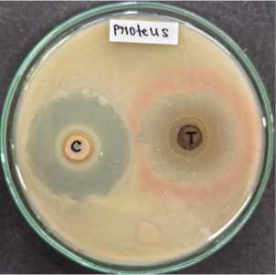
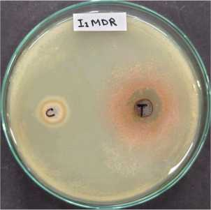
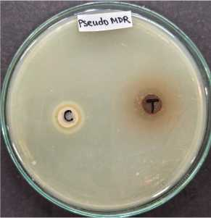
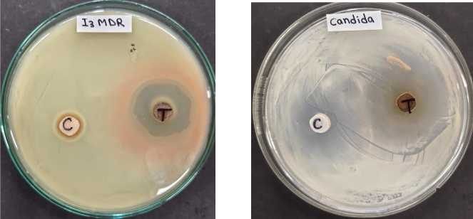
Antimicrobial assay of Se/Ag/Cu NPs
Test organism | Zone of inhibition (mm)
 | Positive control | Nanocomposite
Bacillus | 40 | 40
Staph | 38 | 18
E. coli | 39 | 38
Proteus | 35 | 33
MDR Enterobacter | - | 28
MDR Pseudomonas | - | 26
MDR Klebsiella | - | 29
Candida | 29 | 40
Positive control:
Doxycycline
Fluconazole
Test: Nanocomposite (mixture of- CuNPs dissolved in distilled water, AgNPs dissolved in DMSO and SeNPs as crude in equal proportions)

Slide 12
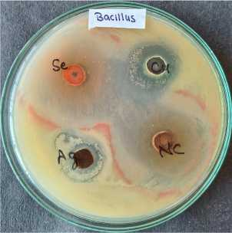
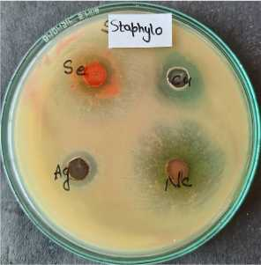
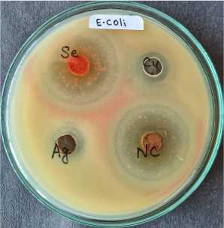
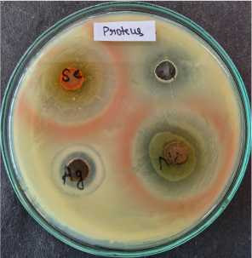
Comparative antimicrobial activity of individual nanoparticles and Se/Ag/Cu nanocomposite (when nanoparticles dispersed in respective solvent)
Test organism | Zone of inhibition (mm)
 | SeNPs | AgNPs | CuNPs | NC
Bacillus | 43 | 19 | 20 | 41
Staph | 33 | 14 | 19 | 30
E. coli | 38 | 15 | 15 | 40
Proteus | 37 | 17 | 15 | 39
Enterobacter | 31 | 18 | - | 30
Klebsiella | 20 | 12 | - | 25
Candida | 44 | 15 | - | 46
Nanocomposite showed a significantly larger zone of inhibitions followed by selenium nanoparticles.

Slide 13
Incorporation of nanocomposite into cellulose matrix used in sanitary napkins and diapers
Sanitary napkins(Brand-Stayfree, JNTL Consumer Health 170 (India) Private Limited, Mumbai, India)
first cellulose layer separated aseptically
Cut into 12 mm diameter discs
100μL of nanocomposite was poured on each disc
Dried under aseptic conditions
SeNPs and AgNPs imparted their reddish color to the NCs
This could be the limitation of the study and needs to work towards diminishing this color to maintain the aesthetic look of the sanitary napkin / the diapers during commercialization of such a product.
a) Cellulose matrix of sanitary napkin (Stayfree), b) discs of cellulose matrix incorporated with nanocomposite

Slide 14
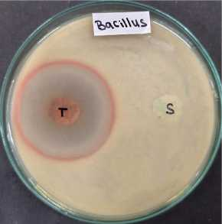
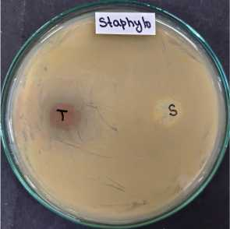
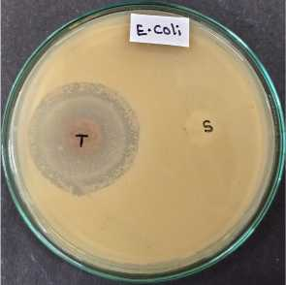
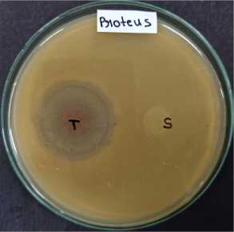
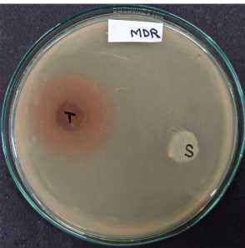
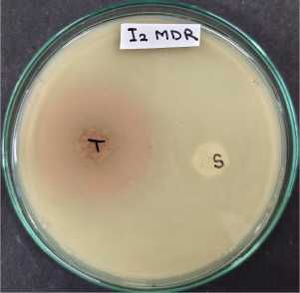
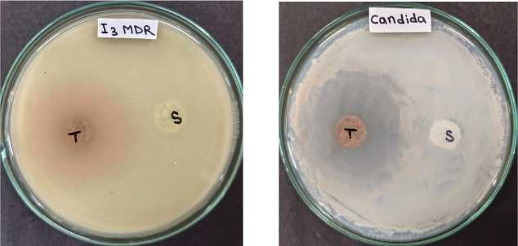
Antimicrobial assay of nanocomposite incorporated cellulose matrix
Test organism | Zone of inhibition (mm)
 | (Sofy disc) | NCs disc
Bacillus | - | 43
Staph | - | 23
E. coli | - | 40
Proteus | - | 38
MDR Enterobacter | - | 27
MDR Pseudomonas | - | 36
MDR Klebsiella | - | 40
Candida | - | 45
No zone of inhibition observed on Sofy antibacterial sanitary napkins (Sofy antibacterial, Unicharm India Private Limited, 163 Gururam, India)

Slide 15
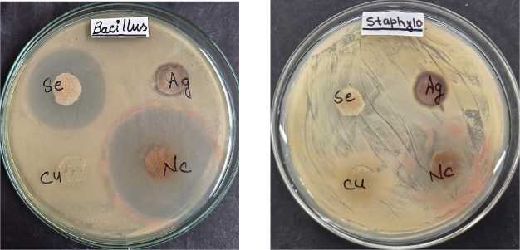
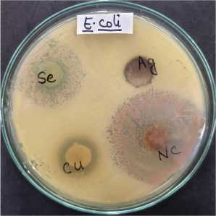
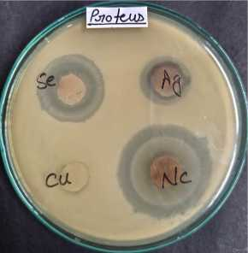
Comparative antimicrobial assay of nanoparticles and nanocomposite incorporated cellulose matrix
Test organism | Zone of inhibition (mm)
 | SeNPs disc | AgNPs disc | CuNPs disc | Nanocomposite disc
Bacillus | 35 | 14 | - | 44
Staph | 25 | - | - | 30
E. coli | 29 | 14 | 21 | 43
Proteus | 26 | 16 | - | 37
MDR Enterobacter | 16 | 14 | 13 | 27
MDR Pseudomonas | 30 | 14 | 18 | 39
MDR Klebsiella | 16 | - | - | 36
Candida | 30 | 13 | - | 46

Slide 16
Conclusion and Future Aspects
Our study focused on improving the antimicrobial properties of sanitary pads and diapers to address the risks associated with prolonged use. By incorporating green-synthesized Cassia fistula leaf extract mediated Se/Ag/Cu nanocomposites into the cellulose matrix, we aimed to create a potent barrier against microbial proliferation. This approach sought to mitigate the risk of urinary tract infections, skin irritations, inflammation, toxic shock syndrome, and candidiasis, thereby improving the overall health and well-being of users.
The future prospects of present study can include the use of biodegradable materials in the nanocomposite based sanitary napkins and diapers to focus more and environment sustainability and comfort of the user. Further biocompatibility assays of the prepared nanocomposite could be done to ensure user safety and concerns.
We can use this nanocomposite in the distribution layer and absorbent core of sanitary napkins and diapers to prevent microbial growth and infection.

Slide 17
References
Foxman B, 2014; Urinary tract infection syndromes: occurrence, recurrence, bacteriology, risk factors, and disease burden, Infect Dis Clin North Am, 28(1):1-13.
Bruna T, Bravo F M, Jara P, and Caro N, 2021; Silver Nanoparticles and Their Antibacterial Applications,Int J Mol Sci, 22(13):7202.
Chen Y, Wu W, Xu Z, Jiang C, Han S, Ruan J, Wang Y, 2020;Photothermal-assisted antibacterial application of graphene oxide-Ag nanocomposites against clinically isolated multi-drug resistant Escherichia coli, Royal Society Open Science, 7(7),192019.
Crisan M C, Theodora M, and Lucian Mocan,2022; Copper Nanoparticles: Synthesis and Characterization, Physiology, Toxicity and Antimicrobial Applications, Applied Science, 12(1).
Daskalova L A, Daskalova D S, Yordanova L P, Pavlova E, Copper and Copper Nanoparticles Applications and Their Role against Infections: A Minireview, Processes,12(2):352.
Danish M, Shahid M, Ahamad L, Raees K, Hatamleh A A, Dosary M A A, Mohamed A, Wasel Y A A, Singh U B, Danish S, 2022, Nano-pesticidal potential of Cassia fistula (L.) leaf synthesized silver nanoparticles (Ag@CfL-NPs): Deciphering the phytopathogenic inhibition and growth augmentation in Solanum lycopersicum (L.), Front Microbiol, 13:2022.
Elim A, Nezhadi S H, 2018; Copper Nanoparticles as Antibacterial Agents, Journal of Molecular Pharmaceutics & Organic Process Research, 6(1):2329-9053.
Eslami H, Ehrampoush M H, Esmaeili A, Ebrahimi A A, Ghameian M T, Falahzadeh H, 2019; Synthesis of mesoporous Fe-Mn bimetal oxide nanocomposite by aeration co-precipitation method: Physicochemical, structural, and optical properties, Mater. Chem. Physics, 224:65-72.
Ermini M L, Voliani, 2021; Antimicrobial Nano-Agents: The Copper Age, ACS Nano, 15(4):6008-6029.
. Gulati R, Sharma S, Sharma R K, 2021; Antimicrobial textile: recent developments and functional perspective, Polym Bull (Berl), 79(8):5747-5771.

Slide 18
THANK YOU

